Slide 1







Quartz Open Framework
BASIC TEMPLATES
DEFINE
COMMIT
DELIVER
LEARN
DESCRIBE
PREPARE
CREATE

Slide 2
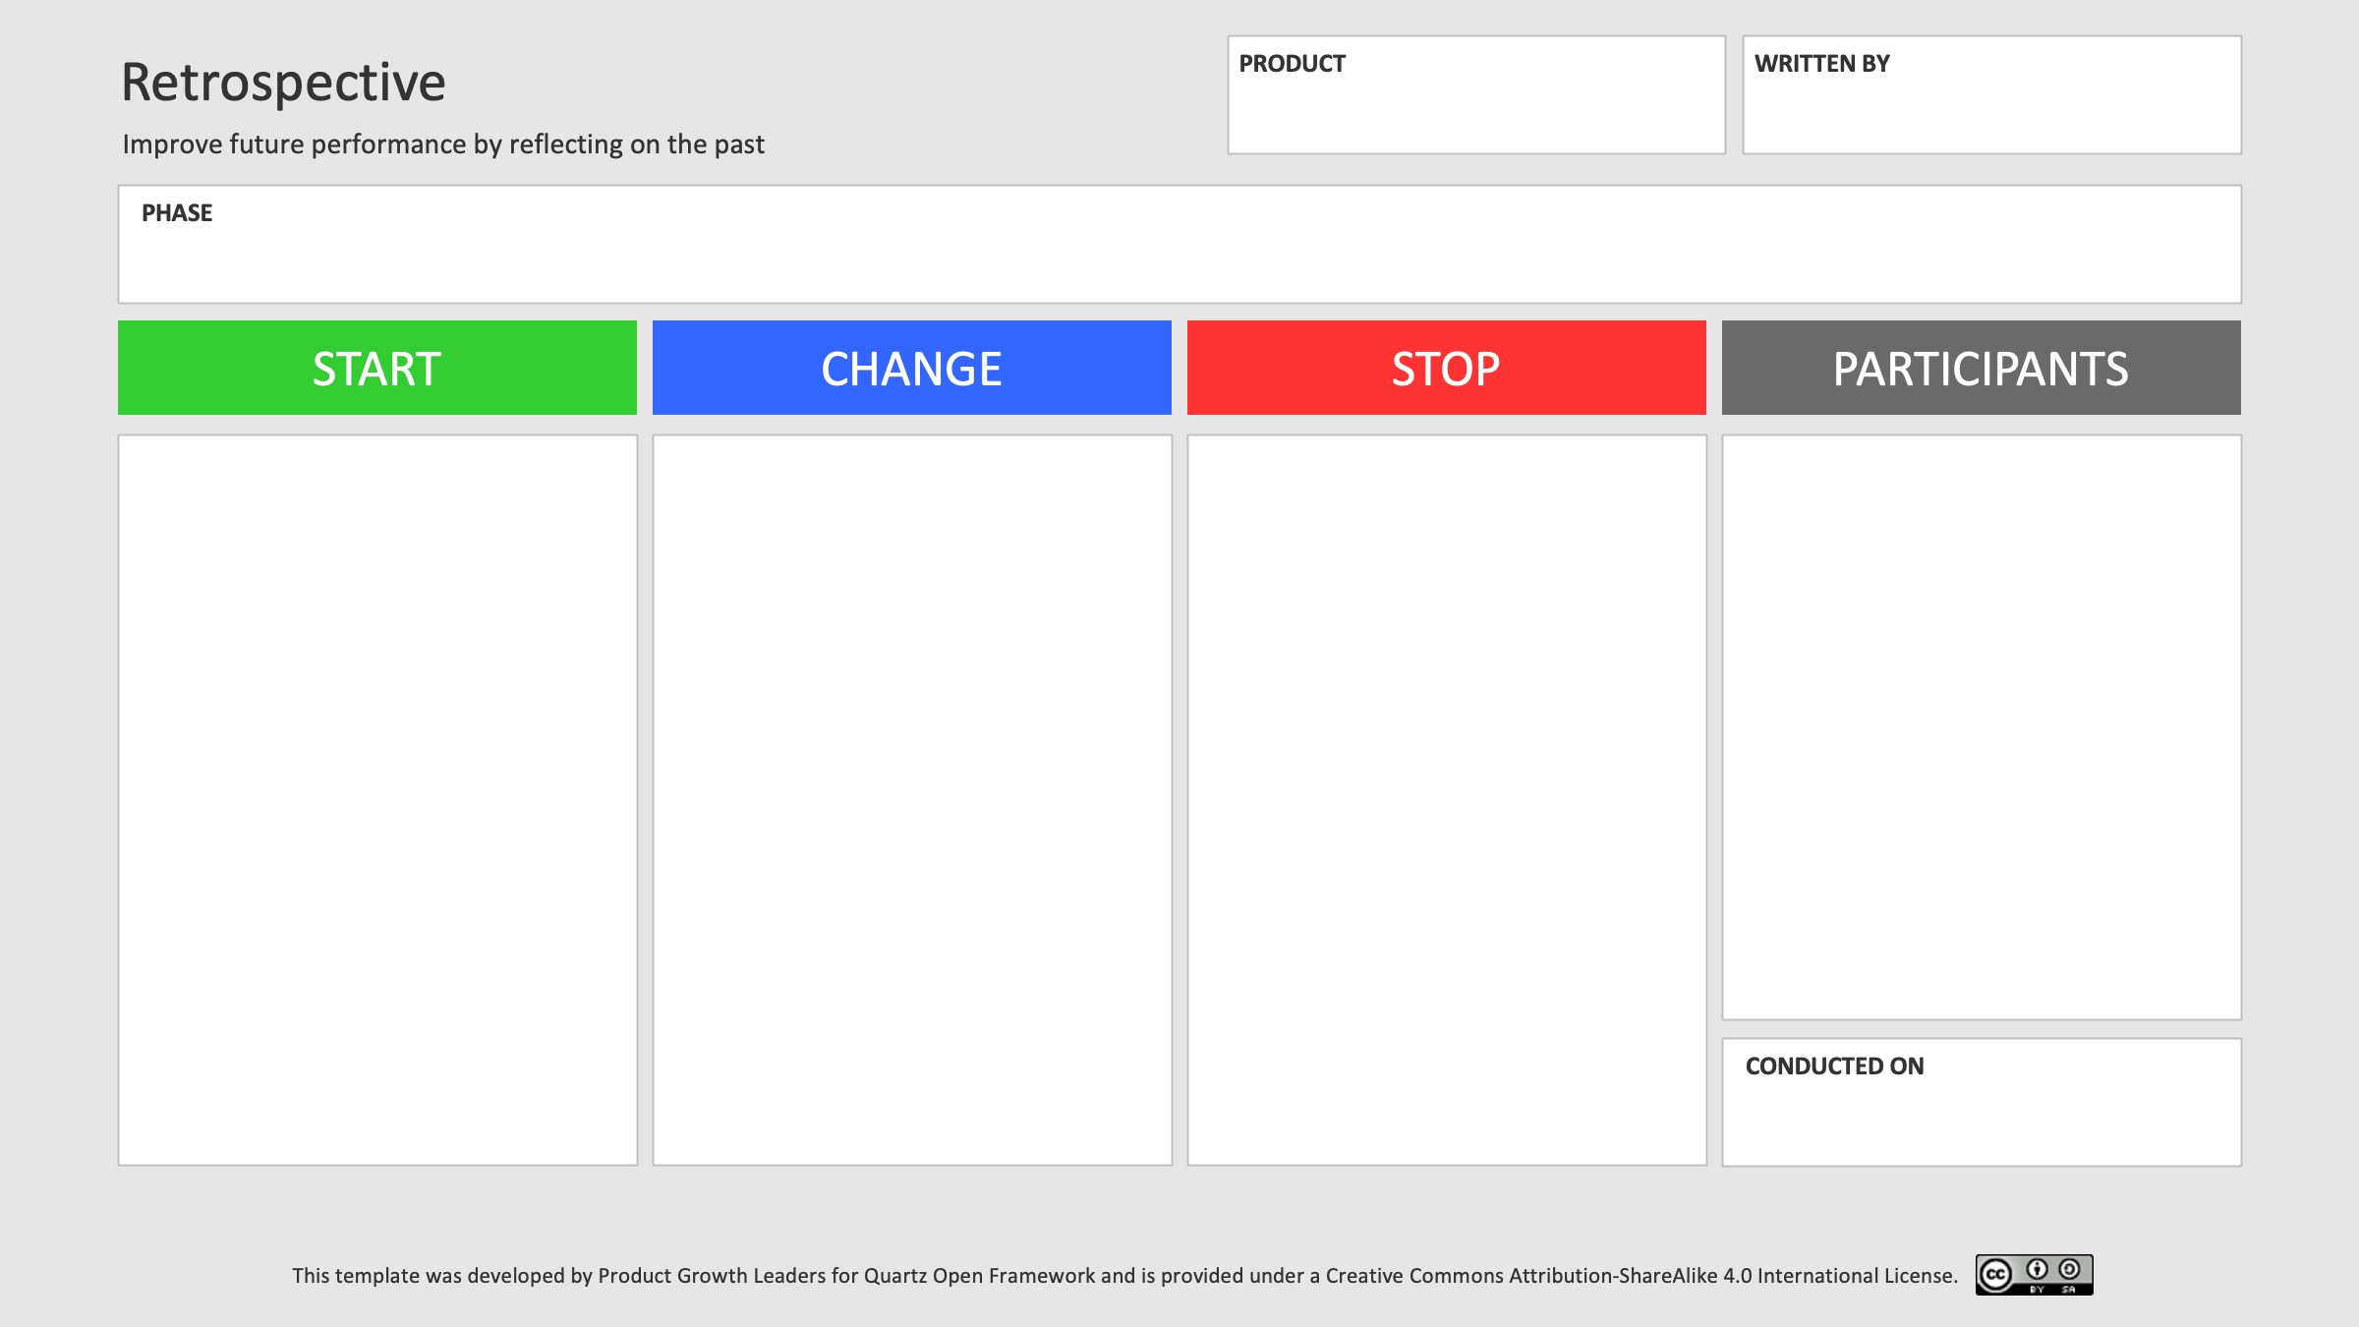
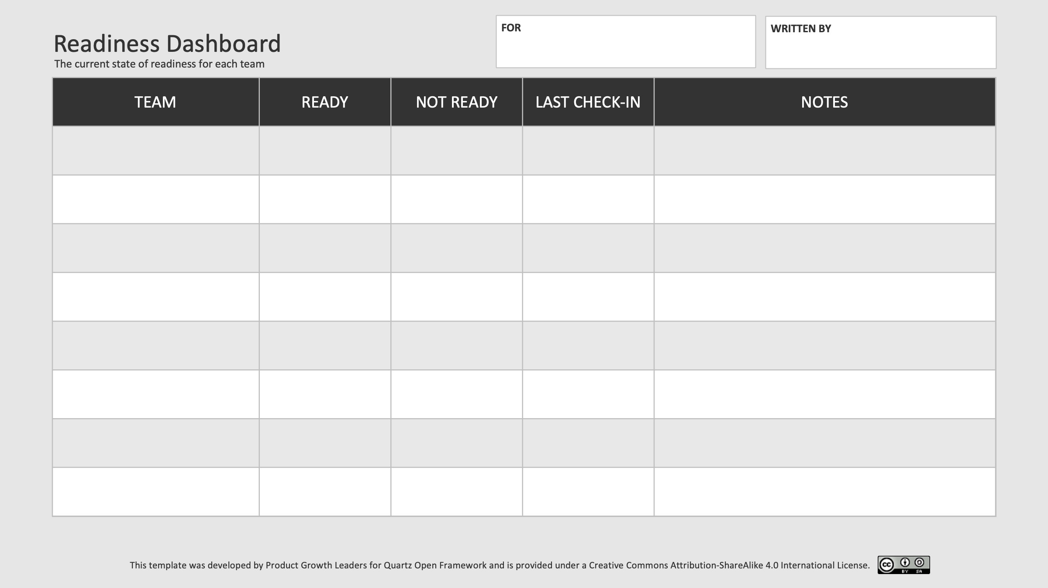
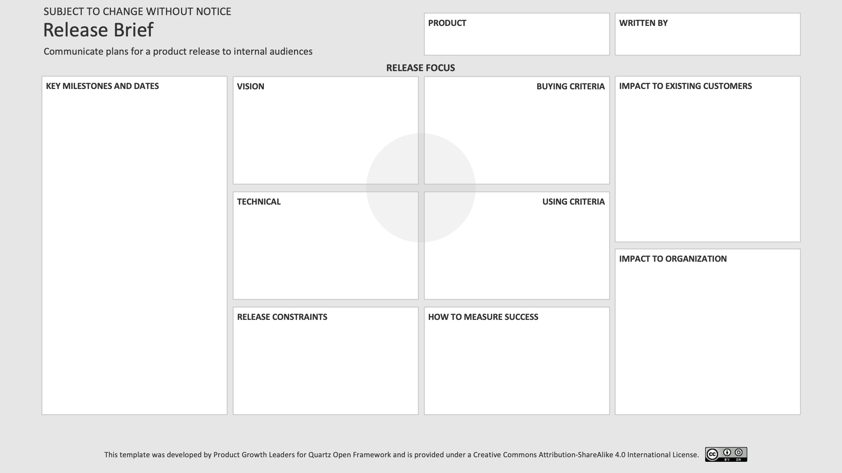
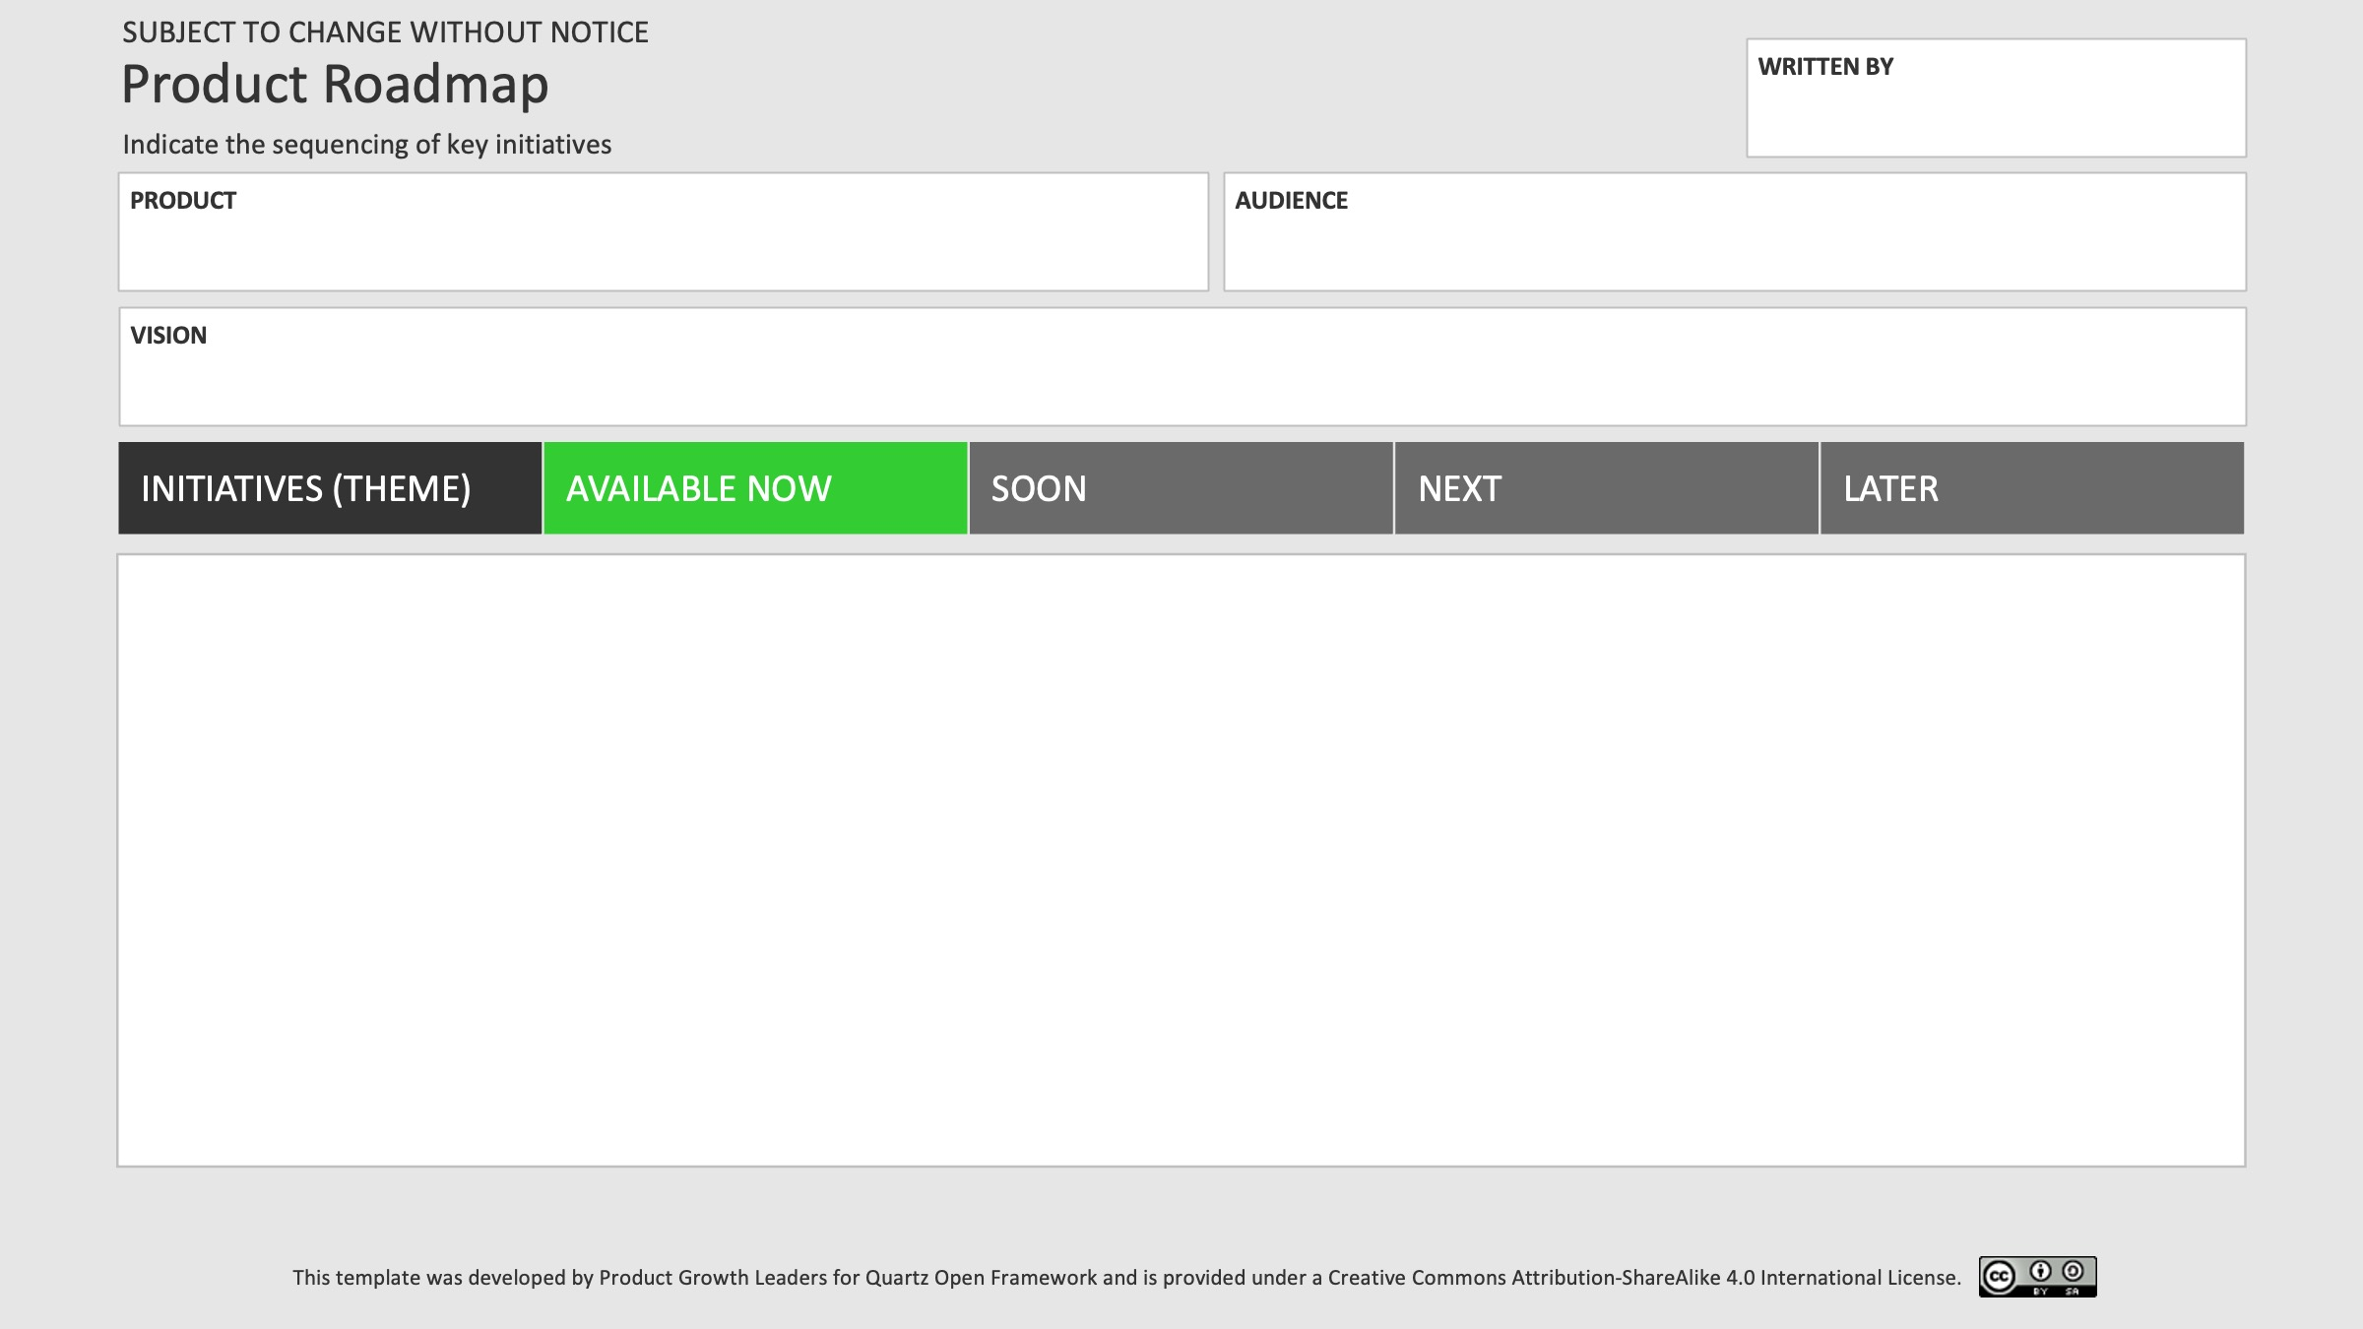
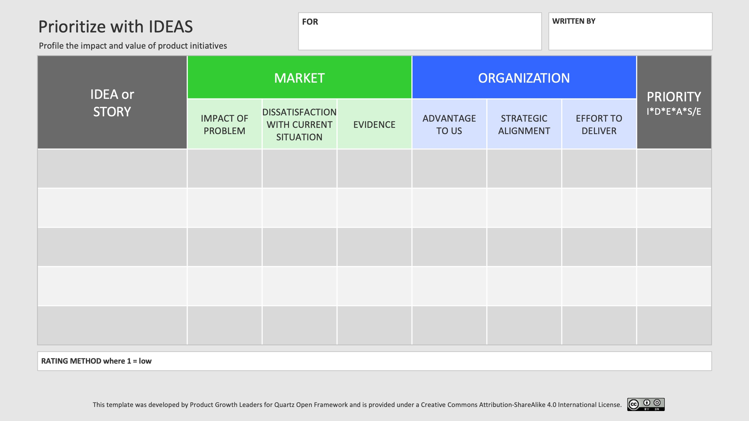
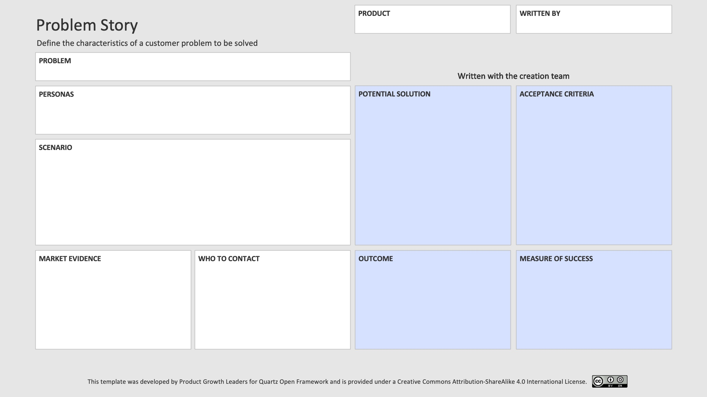
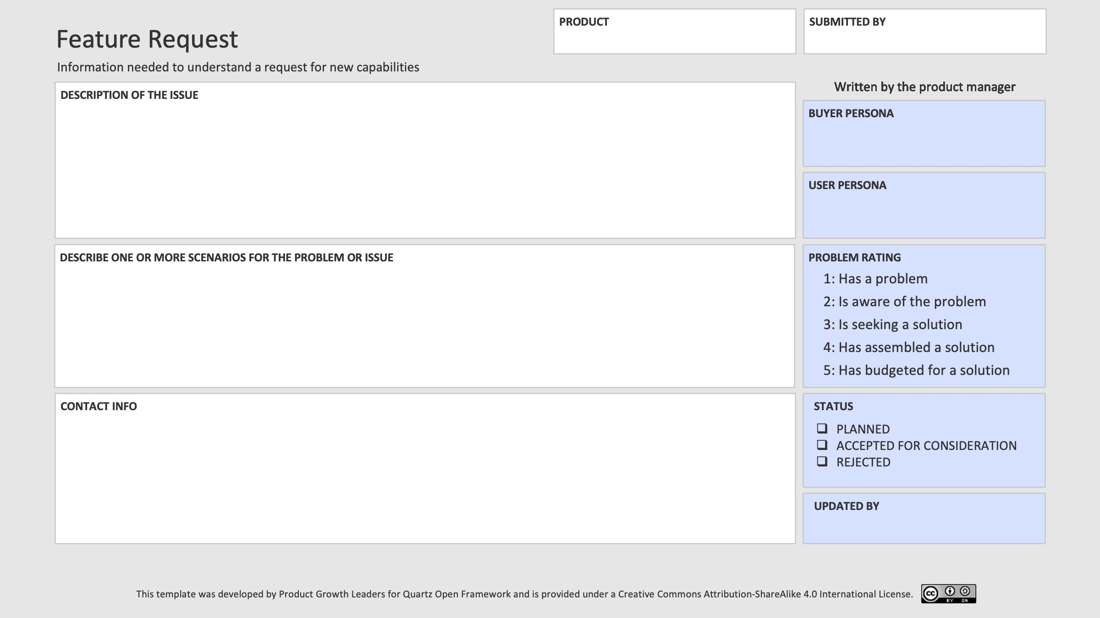
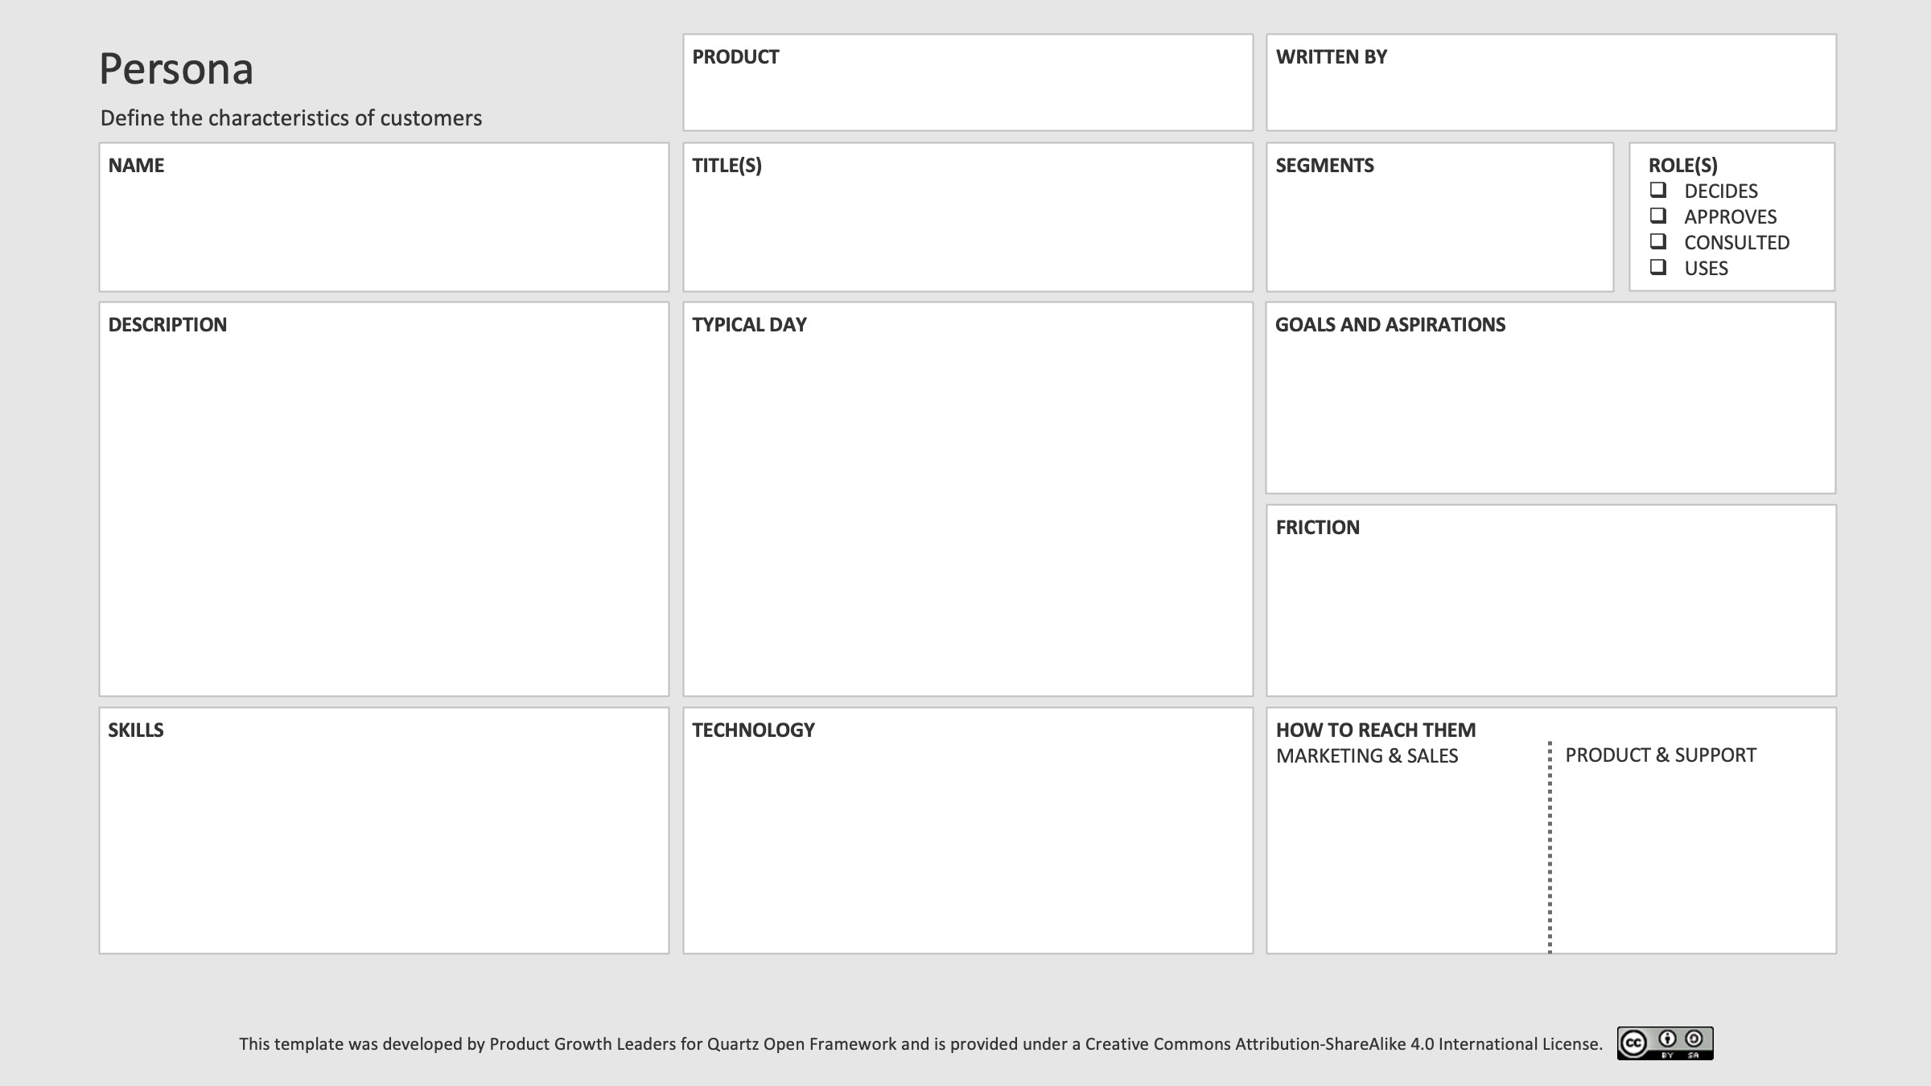
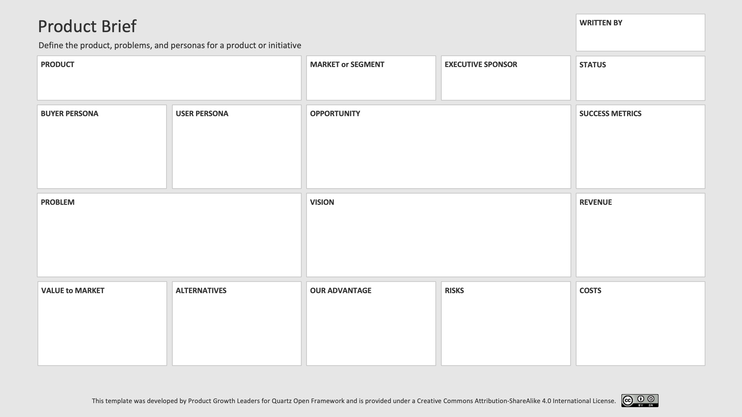
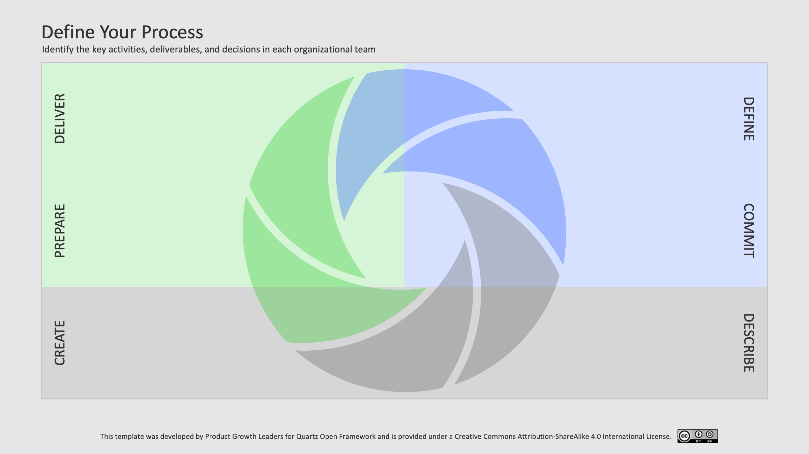
Free Ready-to-Use Quartz Templates

Slide 3

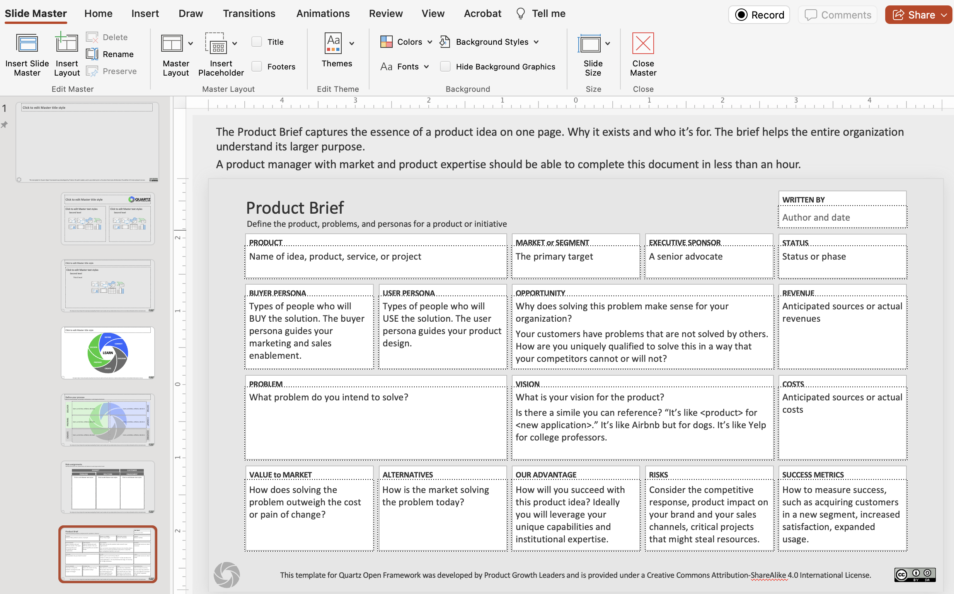
Quartz Starter Templates
Start using the templates as designed to collect information about your product.
Each template master has information above the slide to explain its use.
When you’re ready to tailor them to your business, go into the slide master to edit the labels and prompts. To share with others, save the file as a template and put the template file (.potx) in a shared location.

Slide 4

About the examples
BuzBlu is a fictitious company offering a suite of products for marketing, sales, and operations for small businesses that are used for the examples in this presentations.

Slide 5
Quartz Open Framework

Slide 6
Define Your Process

Slide 7
The Process for Fundamentals of Managing Products
Monitor market feedback
Monitor customer usage
Monitor success metrics
Analyze market feedback
Conduct problem discovery
Create product canvas
Determine launch activities
Develop readiness plans
Prioritize deliverables
Create business deliverables
Define success criteria
Allocate team resources
Get go ahead to proceed
Prioritize deliverables
Formalize acceptance
Communicate status
Describe personas and problems
Define acceptance criteria
Roadmap initiatives or epics
Notes:
Let’s walk through each of the facets to get an idea of the scope of each.

Slide 8
Quartz Process Canvas

Slide 9
Quartz Process Canvas
EXAMPLE
DEFINE initiatives | Identify industries, segments, personas, and problems | Define the initiative | Product Brief | Go/No-Go to Commit
COMMIT to the initiative | Size the market opportunity | Create the business deliverables including roadmap and financials | Business Plan | Go/No-Go to Describe
DESCRIBE the problems | Conduct discovery to learn key problem scenarios | Define personas and problems | Prioritized Backlog | Verify readiness of stories
CREATE the solution | Validate proposed functionality | Prioritize the list of potential capabilities | Release Plan | Accept completed work
PREPARE the organization | Understand the resources needed to deliver | Propose the scope of readiness planning | Readiness Dashboard | Go/No-Go
DELIVER to the market | Monitor product success metrics | Analyze buyer and user journeys | Product Performance Dashboard | Adjust plans based on insights

Slide 11
EXAMPLE
BuzBlu: management tools for small services businesses such as a hair or nail salon
Small services businesses
Version 3 in market. Planning new version 4.
Small business owners are expert in their businesses and not in marketing or technology.
Receptionists with limited computer skills.
Many vendors in this space have been around for years and have convoluted systems with old-style interfaces. But one size doesn’t fit all. We can disrupt the category by solving the most critical issues specifically for this market.
Daily average usage. (The more they use, they more they value and the more they pay for it.)
Small business owners need simple tools to manage their website, promotional emails, and sales workflow. Multiple tools are difficult to use and have too much duplicated information.
All your sales and marketing tools in one place with one source of data, a common look and feel, and designed for regular people.
Monthly license fees based on the usage of various product features. (Pay for what you use).
One license
One UI designed for inexperienced staff
Eliminate redundant tools
Website design tools
Email marketing tools
Lightweight CRM tools
Designed for inexperienced customers.
Intend to offer many ready-to-use templates.
Cutting through the noise of so many alternatives.
Continued spending on existing product teams.

Slide 13
EXAMPLE
Office management systems
Sally, the salon owner
“The Boss”
Small services businesses such as hair salon
A small business owner. She is expert in their businesses but not in marketing or technology.
8:00 AM - The salon opens, and Sally greets clients, assigns staff to their stations, and oversees the morning appointments.
12:00 PM - Sally takes a break for lunch, using this time to catch up on administrative tasks, such as inventory management and bookkeeping.
1:00 PM - After lunch, she resumes managing the salon floor, assisting stylists, and attending to client needs.
5:00 PM - The salon closes, and Sally reviews the day's sales and performance metrics before finalizing staff schedules for the following day..
Keep her customers coming back and ensuring a great customer visit and make sure the stylists have sufficient customers.
Attracting new customers.
Scheduling customers and stylists.
Whenever there’s a technical issue, she has to call a consultant which is both expensive and time consuming.
Good with people and schmoozing customers.
Some limited capabilities with spreadsheets.
She understands cash flow.
Laptop and a mobile phone.
Familiar with Facebook and other social media.
Novice user of QuickBooks but relies on an accountant for anything advanced.
Facebook. She probably has a page for her business.
Email for customer-related information such as billing.
In-app for product notifications.

Slide 14
EXAMPLE
Office management systems
Reese, the salon receptionist
Receptionist, customer service
Small services business
An hourly worker.
The average salon receptionist stays at their job for 1-2 years, based on the 1,996 salon receptionists resumes in Zippia's database.
When Reese arrives at the salon, she checks the appointment schedule for the day and ensures that everything is set up for the stylists.
Reese handles incoming calls, booking appointments, answering questions about services, and providing information on pricing and availability. She ensures that clients in the salon are attended to while still assisting callers.
Overall, Reese's day is filled with client interactions and keeping things running smoothly behind the scenes.
Anything but this job. The job is a steppingstone to a real job.
Cranky customers.
Cranky boss when customers are cranky.
Easily overwhelmed with too many things happening at once.
Good with people and schmoozing customers.
Desktop computer. Uses her personal mobile phone.
Extensive experience with Facebook, WhatsApp, TikTok, and other social media.
n/a
In-app notifications

Slide 16
EXAMPLE
Office Management Systems
Online booking of appointments and services
Small business owners
Salon Receptionists and customers
3
Today we have a big calendar book that we write in by hand. More and more of our customers want to be able to book appointments online but we are concerned about double-booking if we have both online and paper calendars.
Furthermore, many customers want to book multiple or repeating appointments.
Our customers want a reminder of their appointments. [Remember, our customers have mobile phones.]
Our stylists need to know their schedule and need to be able to specify when they are available.
John Smith <john@company.com>
Susan Jones <susan@company.com>
Layla Khan <layla@company.com>

Slide 18
EXAMPLE
Office Management Systems
Online booking of appointments and services
Salon receptionists and customers
Customers and receptionist must be able to book an appointment with a preferred stylist.
Must not allow double-bookings.
Must not require a third-party product such as Facebook
Our customers want to be able to book appointments online. Many customers want to book multiple or repeating appointments.
In a survey of customers 30% ranked this in their top 3 problems.
This was the top issue identified by the customer advisory board.
John Smith <john@company.com>
Susan Jones <susan@company.com>
Layla Khan <layla@company.com>
Increase the number of appointments with easier ways to book.
% of appointments scheduled online versus phone calls.

Slide 20
EXAMPLE
BuzBlu summer release
Online bookings | 5 | 5 | 5 | 4 | 4 | 4 | 500
Email marketing updates | 3 | 4 | 2 | 3 | 3 | 2 | 108
Stock photos | 1 | 1 | 1 | 1 | 1 | 2 | 1
Online shop | 4 | 3 | 3 | 5 | 5 | 5 | 180
SEO updates | 2 | 2 | 4 | 2 | 2 | 3 | 21

Slide 22
EXAMPLE
Spring
Fall
WEBSITE | Superior web design platform New color palette chooser Basic email marketing tools | Online bookings SEO updates Content and image manager | Integrated email marketing using content and image manager AI-generated newsletters and emails | Advanced calculated field for content manager Automated responses to inquiries
E-COMMERCE |  | Product inventory for in-store sales

Slide 24
EXAMPLE
BuzBlu summer release
Expand self-service and email marketing options
Expanded catalog of graphics and images
3
7
15
64
User-defined databases allow dynamic fields in newsletters, emails, and webpages
Self-service capabilities
An attractive prospect could demand custom work that derails the release plan.
Need to ensure GDPR compliance and PIP protection.
Online shopping capabilities must be available by the end of Q3 or clients will miss the lucrative holiday shopping season.
Increased sales of our product
Adoption of new capabilities

Slide 25
TEAM | READY | NOT READY | LAST CHECK-IN | NOTES

Slide 26
EXAMPLE
BuzBlu e-commerce release
TEAM | READY | NOT READY | LAST CHECK-IN | NOTES
Customer success | • |  | 14-May
Legal | • |  | 14-May
Marketing | • |  | 14-May
Operations |  | • | 8-March | No one assigned
Partners and channels | • |  | 14-May
Product marketing |  | • | 8-March | No one assigned
Professional services | • |  | 14-May
Sales | • |  | 14-May
Support | • |  | 14-May

Slide 28
EXAMPLE
BuzBlu summer release
Ensure every product has a product manager.
Clearly define roles and responsibilities.
Define deliverables and decisions at each step of the Quartz Open Framework.
Create one-page briefs for product, persona, release, launch readiness.
Prioritize for business value using IDEAS.
Focus on outcomes, not outputs.
Share roadmaps, plans, and schedules with internal teams.
Perform retrospectives after each release.
Focus on the vital few, not the compelling many.
Improve the communication between product and customer-facing teams.
Share persona use scenarios instead of feature requests.
Determine how to measure the impact of new features on the customer and company before building it.
Change focus from launch deliverables to launch readiness.
Stop expecting more than can be done at the current staffing level.
Stop wasting effort in business planning details before getting executive commitment.
Stop putting dates on roadmaps.
Stop taking custom work unless its your business model.

Slide 29



DEFINE
COMMIT
DELIVER
LEARN
DESCRIBE
PREPARE
CREATE
Quartz process [ppt] (select facet to change color)

